Slide 1
Key And Mouse

Slide 2
OUTLINE
Key Interface
keyPressed
keyTyped
keyReleaesed
KeyEvent
Animator Class
Example
Mouse Interface
MouseEntered
MouseExited
MouseEvent
Example
Class Activity

Slide 3
Key Interface
KeyListener is an interface use to interaction with the Keyboard.
All user define class can be implemented more than one interface separated by coma ( , ).
KeyListener interface has three Abstract Method ( keyPressed( ), keyReleased() and keyTyped().
Public void keyPressed( KeyEvent e){}
Public void keyReleased( KeyEvent e){}
Public void keyTyped( KeyEvent e){}

Slide 4
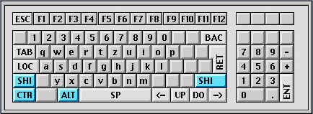
Key Pressed
KeyPressed() method will called when we pressed any key on the keyboard.
kyePressed() method works with modifier keys
KeyPressed() method also works with Capital letters

Slide 5

Key Typed
KeyTyped() method will call when we type any key on the method.
the modifier keys and Capital keys not works here.

Slide 6
Key Released
KeyReleased() method will be called when we release a key on the keyboared.
For example:
On press
On Release

Slide 7
KeyEvent
An event which indicates that a keystroke occurred in a component.
getKeyChar() and getKeyCode() are the most popular methodes inside KeyEvent class
getKeyChar() return the pressed letter
getKeyCode() return the (ASCII) code of the pressed letter
1_V
6_V
2_V
5_V
3_V

Slide 8
`
EXAMPLE

Slide 9
Mouse Interface
MouseListener is the interface to interacting with the mouse.
Also it have some abstract methods.
public void mouseClicked(MouseEvent e)
public void mousePressed(MouseEvent e)
public void mouseReleased(MouseEvent e)
public void mouseEnteredMouseEvent e)
public void mouseExited(MouseEvent e)

Slide 10
MouseEntered
This method will be called when you enter to the canvas.

Slide 11
MouseExited
This method will be called when you leave the canvas.

Slide 12
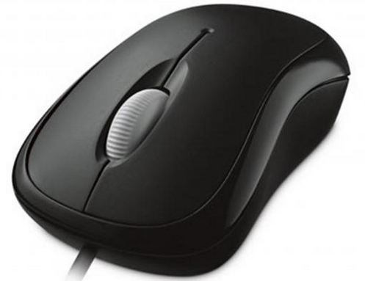
MouseEvent
An event which indicates that a mouse action occurred in a component.
We have many methods inside MouseEvent class
getButton(): use to return type of mouse button the you clicked (1,2 or 3 should be returned)
3
1
getX(): return X value on the frame when you clicked
getY(): return Y value on the frame when you clicked
2

Slide 13
EXAMPLE

Slide 14
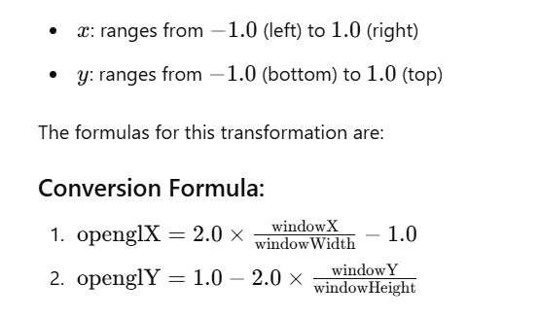
Window coordinate to OpenGL coordinate

Slide 15
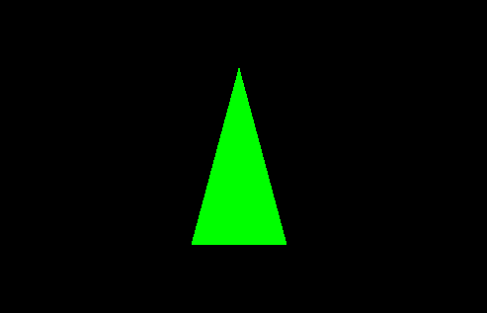
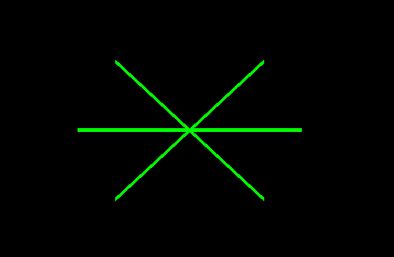
Class Activity
Left click
r= red , g=green , b=blue
Right click
r= red , g=green , b=blue

Slide 16
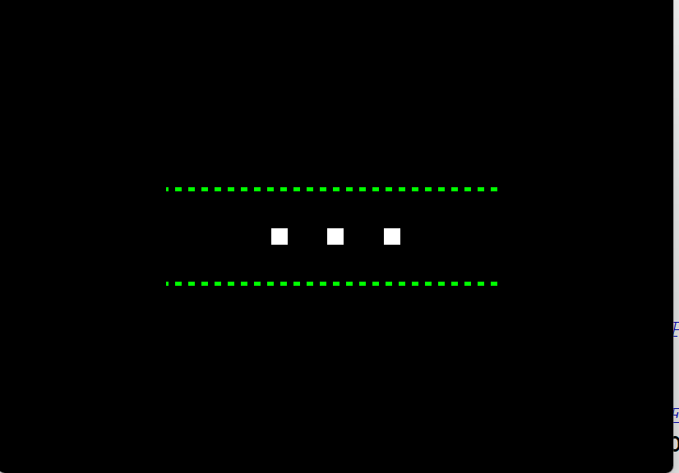
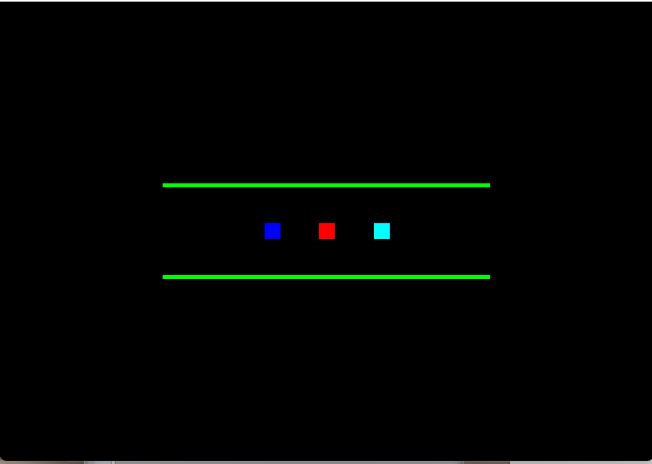
Left click line stippled
Right click line stippled disabled
r= red , g=green , b=blue

